Slide 1

Dementia and Fall Risk:
A Caregiver’s Perspective
Thank you for joining us this evening.
We will be starting soon.
If you experience any technical problems during the webinar, please notify us in the chat or email
Joy.Richards@usask.ca

Slide 2

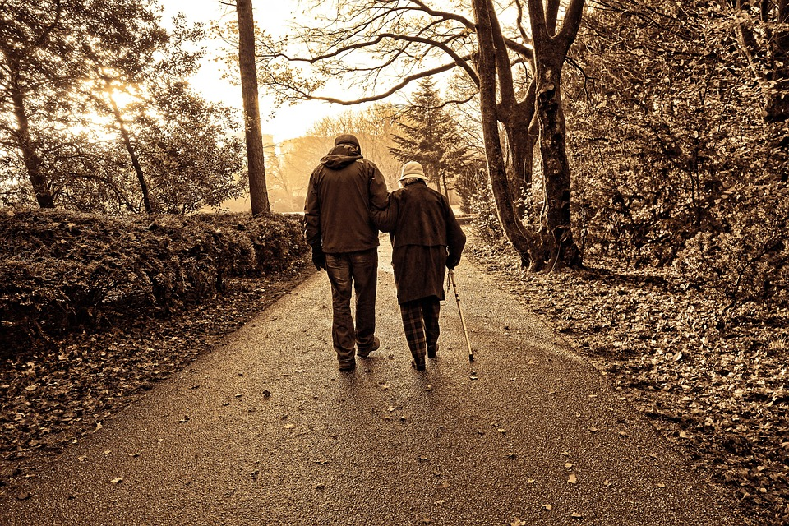
Why this Study?
Dr Cathy Arnold
School of Rehabilitation Science – College of Medicine, University of Saskatchewan
  Falls leading cause of injury hospitalization
    20 to 30 % of older adults fall every year
  From a previous study of older adult/health care providers’ perceptions of falls, risk and post-fall care*
    Many older adults believe “it won’t happen to me”
    “we need to be proactive”
  Being proactive, identifying and mitigating risk does help to prevent falls
A Collaborative Approach to Fall Risk Identification, Prevention
and Post-Fall Care for Older Adults in Saskatchewan. Arnold, Kemp et al.
Notes:
Falls are the leading cause of injury hospitalization across Canada as well as Saskatchewan, with about 20-30% of older adults falling every year living in the community and closer to 50% in long term care. As of July 01 2021, the older adult population in Saskatchewan is close to 17% and that will continue to rise in the future. The study we are reporting on today branched from a larger study we started about 4 years ago where we were investigating older adults and health care providers experiences of falls, assessing fall risk, and post-fall care and follow-up through a survey and focus groups. We learned that many older adults who fell were surprised, they didn’t think it would happen to them, even though they did know the risks are there. Further to this, older adults and health care providers said they know that falls can be prevented by identifying and mitigating risk, but we need to be more proactive to prevent the fall in the first place.
We also determined that even though some of our focus groups included caregivers and family members, there were experiences that indicated the need to determine the impact that falls have on caregivers, particularly for caregivers of people living with dementia. We received funding to branch this research further and Michaela will be sharing what we did and some of the early results.

Slide 3
What are the risk factors?
Biological (the person): age, frailty, previous falls, diseases and conditions including cognitive, balance, muscle strength, vision, incontinence, nutrition, sleep
Environmental: medications, home hazards, outside hazards, prolonged hospital stay, need for assistance
Socioeconomic: unable to afford equipment, isolated, lack of social supports
Notes:
So what are the risk factors for falling?
There are hundreds… and they are cumulative, so the more risk factors you have, the greater risk there is. We can classify these into three main categories, all have ability to modify to an extent, and important to consider all of these when assessing risk.
Biological are the person factors: go through these… some modifiable others not
Environmental or external factors
Socieconomic:

Slide 4


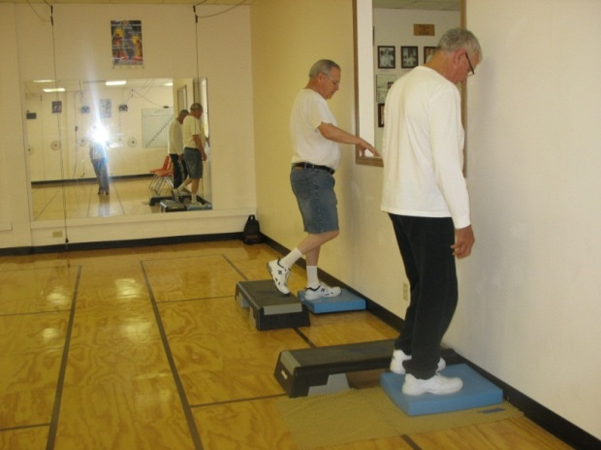
Primary “Person” Modifiable Fall Risk Factors
BALANCE:
  Ability to “wobble but not fall down”
  Many things help balance (vision, ears, muscles, nervous system, feet, reactions, NOT multi-tasking…)
  And it’s winter in Saskatchewan
MOBILITY
  Feet, legs, back, arms
STRENGTH
  Big leg muscles
  Trunk and arms too!
Notes:
There are three main factors for the person aspect of risk that are modifiable and known to contribute to risk of falling, and can be improved with exercise and attention to day to day living activities where risks are higher.
Balance – is the ability to stay upright and navigate the bumps, the shifts of movement in day to living and stay on your feet. There may be wobbles, but not the fall. There are many things that contribute to better balance, and not cover all today.. Mention a few
Mobility – refers to the extent of movement or agility you have generally, but specific to falls and balance important to ankles/feet, hips and knees, spine, and less so, but not excluded arms (shoulders) to be able to react, move smoothly
Strength: Importance for day to day activities, getting out of a chair, tub, toilet seat, walking, catching balance, big leg muscles back side and thighs, but also trunk and arms.
All of these can be mitigated by staying active and participating in exercise that focuses on them

Slide 5
Associated Activities resulting in falls
Public Health Agency of Canada 2nd Report, 2014
Notes:
What are the main activities associate with falls – WALKING is primary one note that very limited sport activity or during exercise, others important to consider stairs, rising from furniture

Slide 6
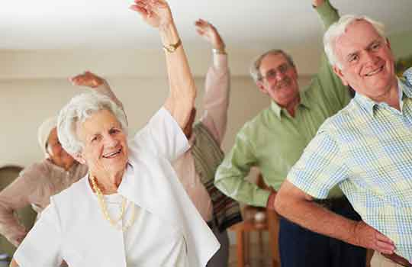
Ways to Prevent Falls
Exercises to improve balance, strength and mobility
Understand risks, home and community hazards
Seek help, get assessed (one size fits all doesn’t apply)
Caregivers need information and support
Notes:
There are many ways to prevent falls, exercise is one of the top ones we know helps also identifying risks around you and take action to decrease them
If concerned about falls, get an assessment, a physiotherapist is an expert in identifying balance strength and mobility
Use resources… caregivers need information and support.. Why we are here tonight, to share some of the experiences we heard in our study and to generate discussion about the needs of caregivers in relation to falls and fall prevention.

Slide 7
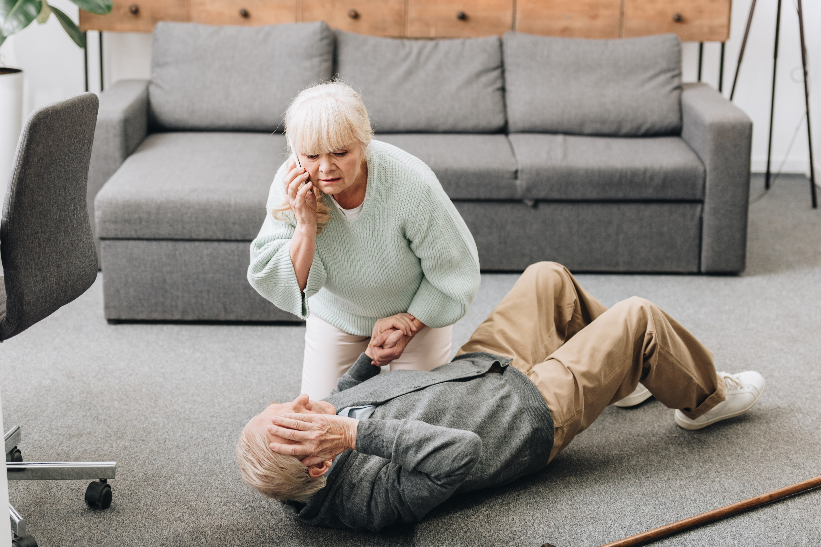
Caregiver experiences of falls in people living with dementia
Dr Michaela Lynds
School of Rehabilitation Science – College of Medicine, University of Saskatchewan

Slide 8
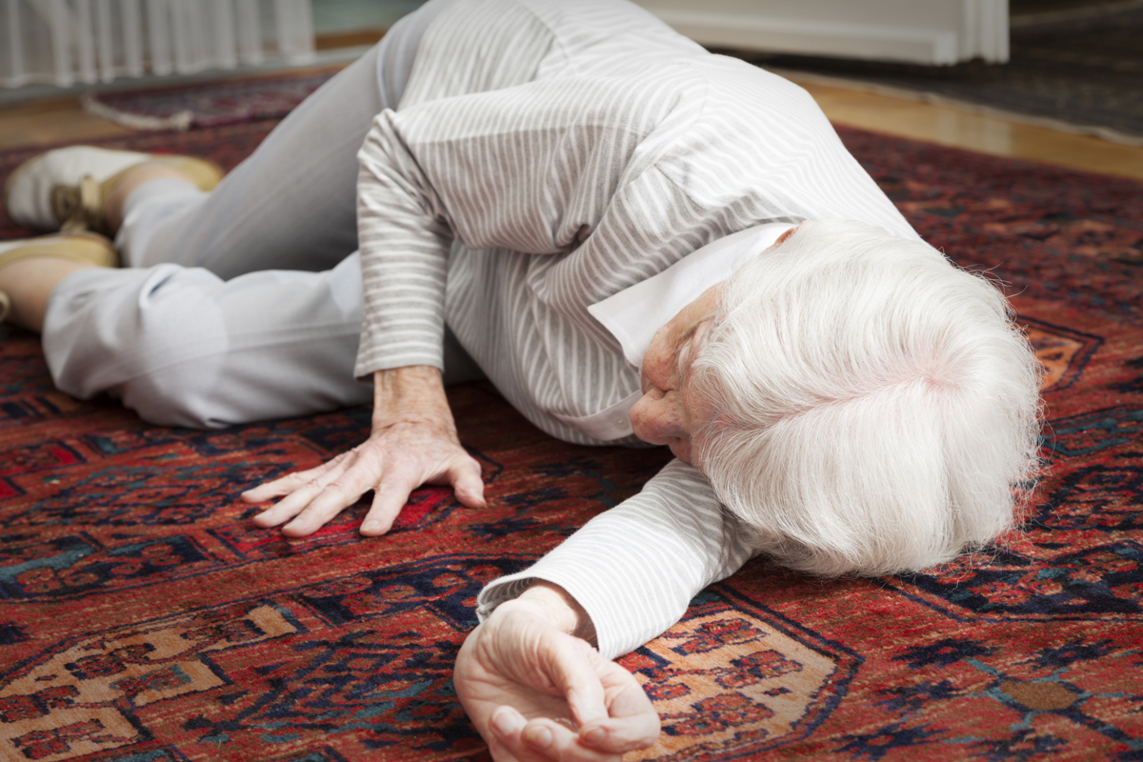
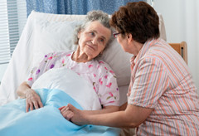
Introduction
PLWD are at a much higher risk of falling, with an annual fall rate of 60-80% compared to approximately 30% in the general older adult community-dwelling population.
15% of emergency department visits by PLWD are fall-related, compared to 9% among older adults who do not have cognitive impairment
There are currently over 500,000 PLWD in Canada and more than
76,000 people are being diagnosed each year.
By 2031 the number of PLWD in Canada is projected to be at least 937,000.

Slide 9
Research design
Scoping Review
What do we already know about fall risk
assessment for PLWD?
Questionnaire
Obtain data and demographics from informal caregivers.
Interviews
Explore caregivers experiences in more detail.

Slide 10
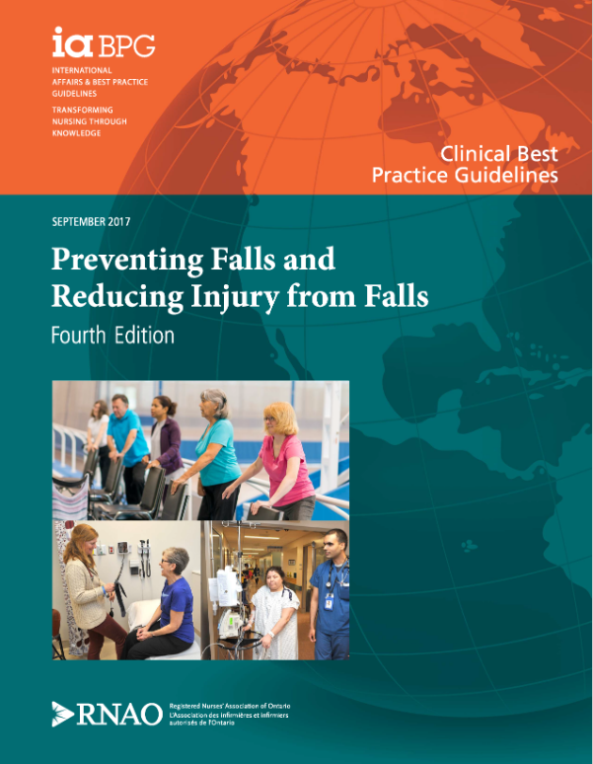

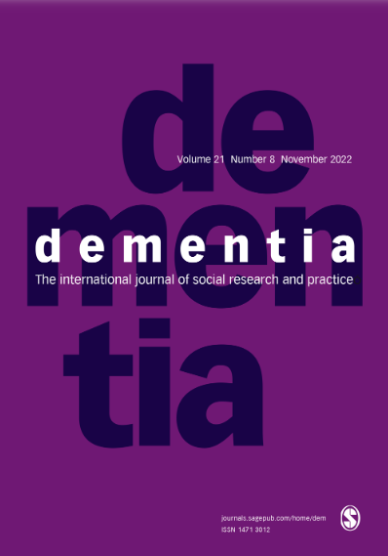
Scoping Review
Purpose
To identify and summarise recent research, practice guidelines and grey literature which have considered fall risk screening and assessment for PLWD.
Methodology
Extensive search of six electronic medical databases, grey literature and online sources.

Slide 11
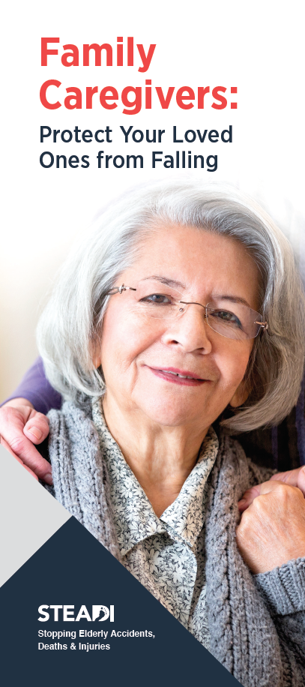

Scoping Review
Not all fall risk screening and assessment tools may be suitable for use with PLWD.
The most meaningful fall risk assessments for PLWD are those which include:
  Activities of Daily Living
  Dual-Tasking
If they are to be successful, fall prevention interventions must be built on a solid foundation of knowledge regarding the individual needs of the PLWD.
This can only be achieved if appropriate fall risk assessment methods are identified and utilized.

Slide 12

Questionnaire
Purpose
To obtain information regarding the number and circumstances of falls in PLWD, and the experiences of the informal caregivers.
Methodology
Online questionnaire
Definition
Any relative, partner, friend or neighbour who provides assistance for someone living with dementia. This may include such things as personal care, help with shopping, companionship and meal preparation. The caregiver may live with, or separately from, the person receiving care.

Slide 13
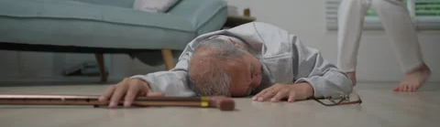
Questionnaire
54% of the caregivers live with the PLWD.
36% of the caregivers are the spouse of the PLWD.
62% of falls in the last 12 months resulted in injury.
41% of falls in the last 12 months resulted in hospitalisation.
65% of PLWD did not understand or remember why they had fallen.

Slide 14
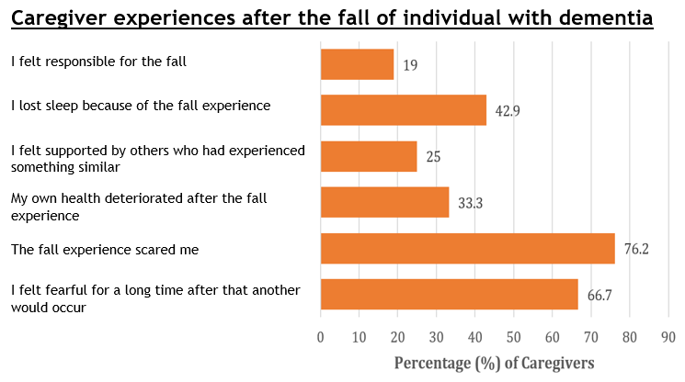
Questionnaire: Results

Slide 15
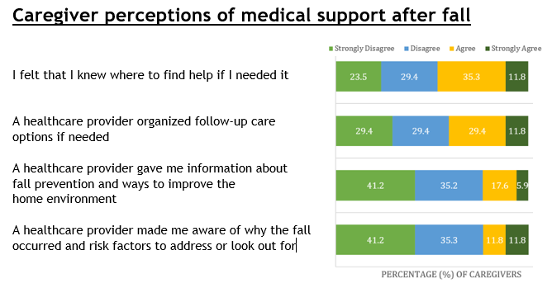
Questionnaire: Results

Slide 16
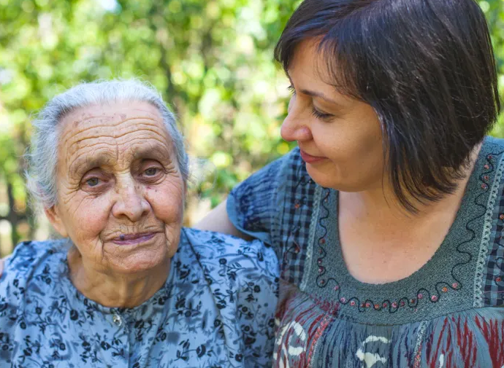
Interviews
Purpose
To enable further exploration of the answers to the questionnaire
To give the informal caregiver an opportunity to share their emotions and experiences of caring for a PLWD who is at risk of falling.
To explore the experiences and opinions of the informal caregiver when they interact with the healthcare system.
Methodology
Semi-Structured interviews via Zoom

Slide 17
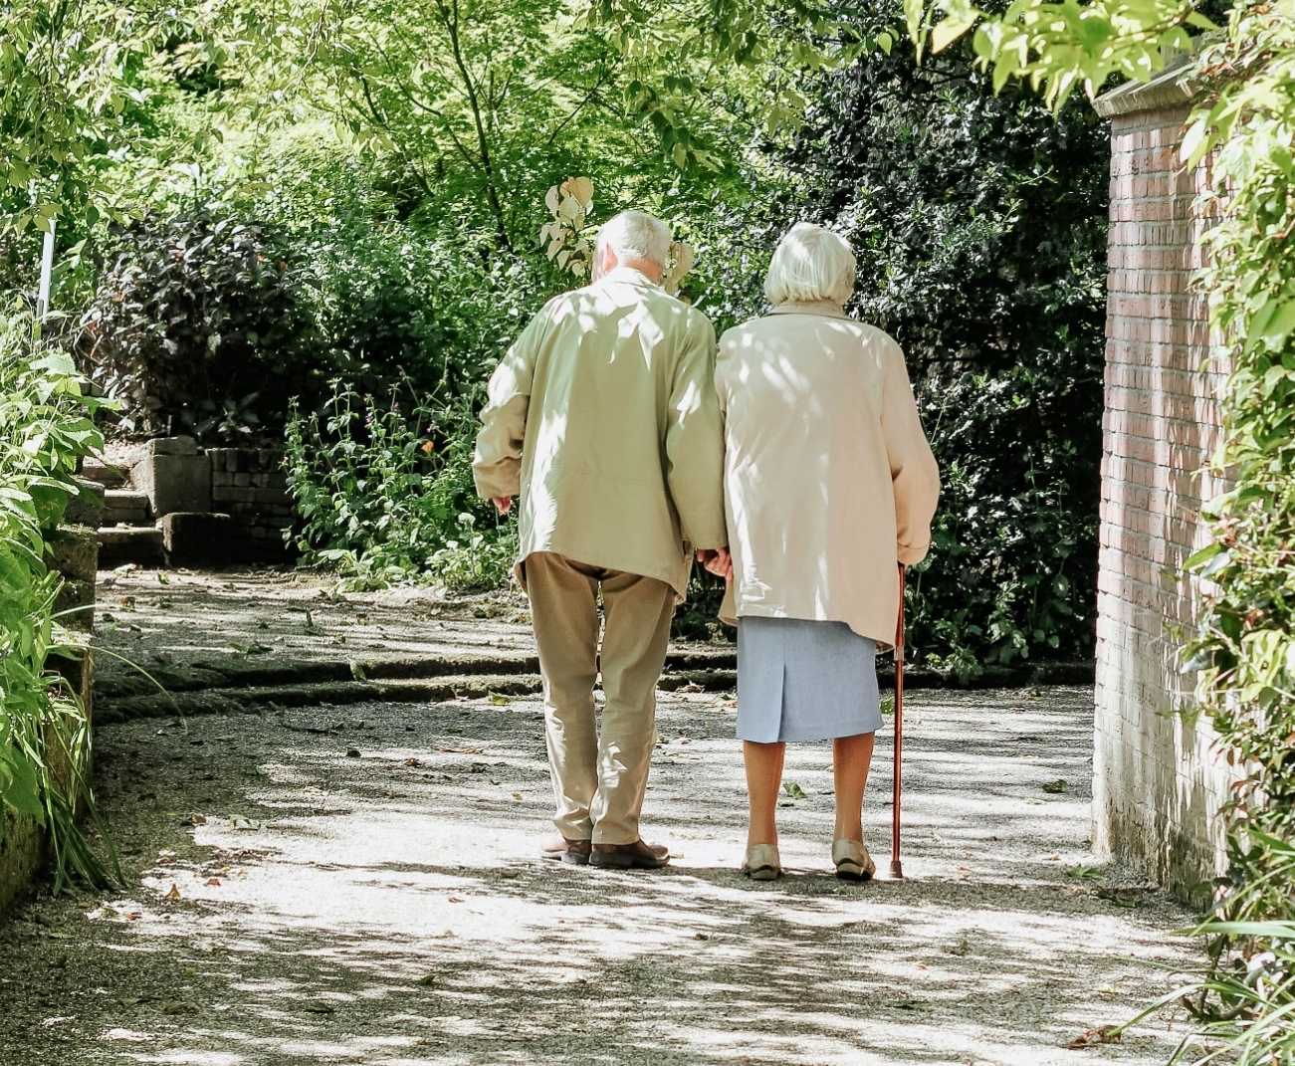
Interviews
“One minute she was there and the next she was on the ground and
had hit her head and her elbow and her arm”
“The facility didn't tell me that’s
why he fell”
“Looking ahead is really frightening”
“Some days I don't want to
have to do it all by myself”
“He fell in the front room, I think he was just getting up off the sofa
with a cup of coffee”

Slide 18
Interviews
Perception that fall accelerated the progression of the dementia
“I can see it declining. Since the fall his dementia has really progressed. That fall really moved the dementia on.”
Concern for the PLWD moving to long-term care
“She fell twice, both of the falls she was set back, cognitively what she could do, what she could remember. She right on the very edge now, she'd go from acute care right to long term care.”

Slide 19
Interviews
Need for ‘coaching’ to prevent falls/get up
“it took me probably 45 minutes before I could get her up off the ground because… she couldn't get her mind around what she was supposed to do”
“you have to say, "Toward the bed," or, "Toward me," whatever. And, "Now put one foot down. Now, put the other foot down. You're going to get up on both feet. You can do it”

Slide 20
Interviews
PLWD doesn’t remember or understand a fall event
“if she did fall, she could probably, quite easily, walk around on maybe a broken ankle or something and not even realize it”
“as far as my mom was concerned, the fall—unless she was feeling pain right now, she didn’t remember the fall at all”

Slide 21
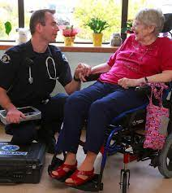

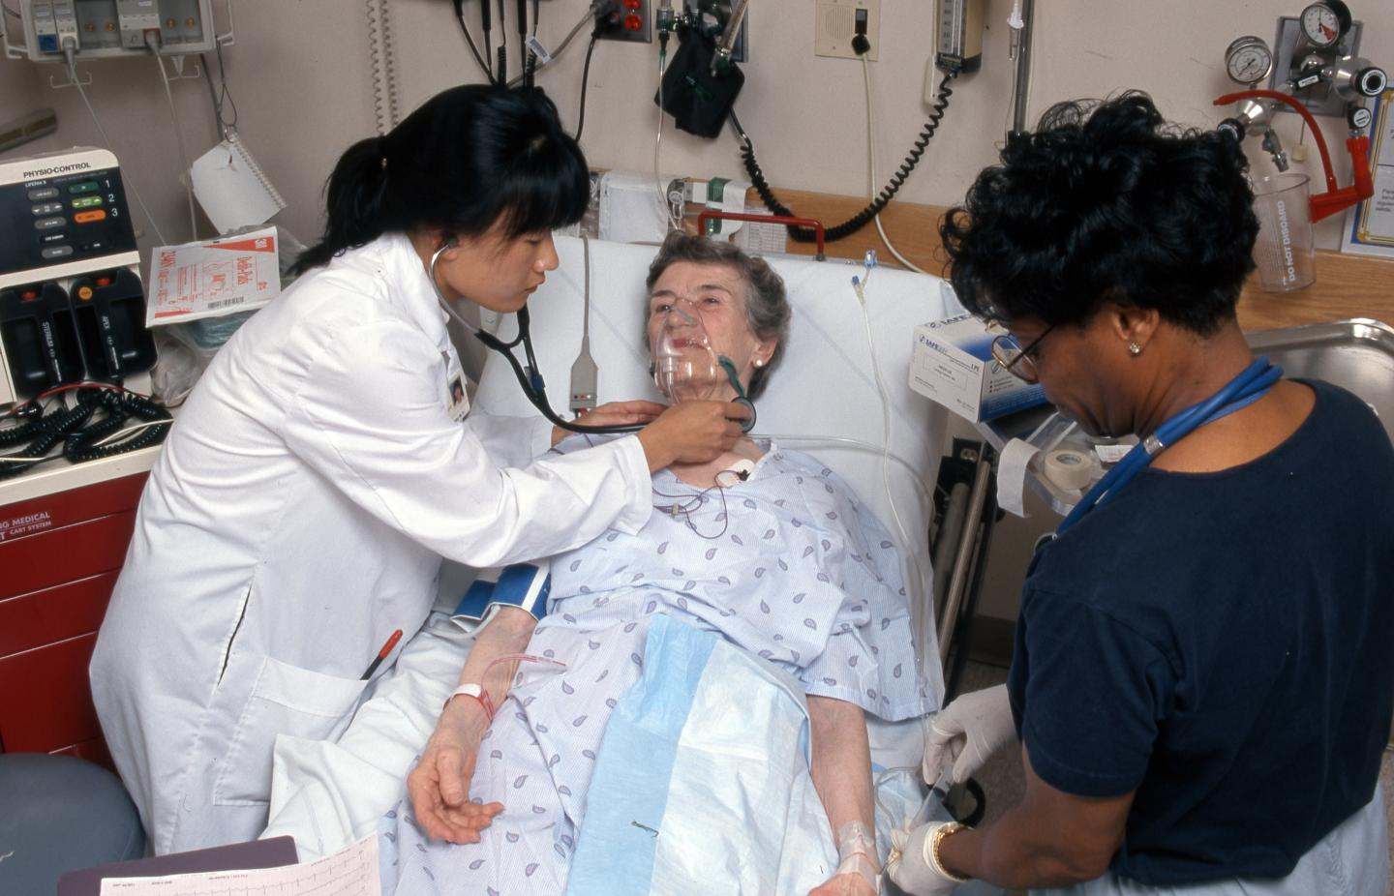
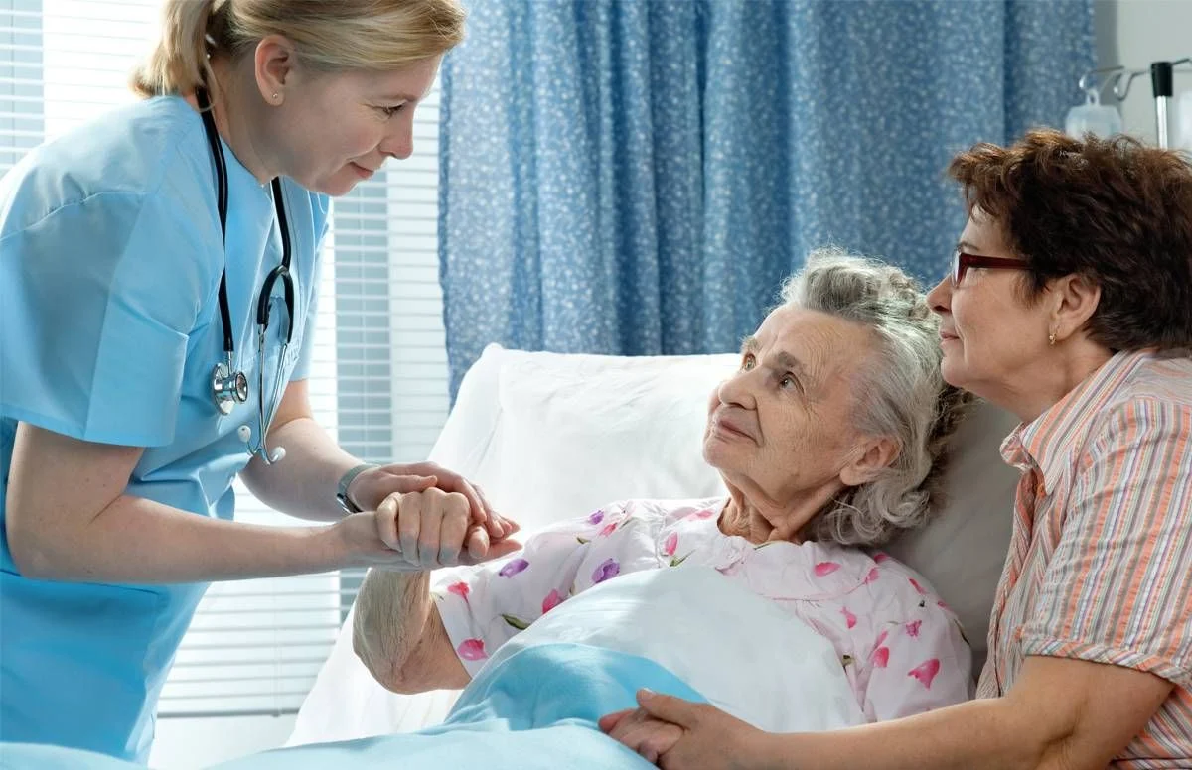
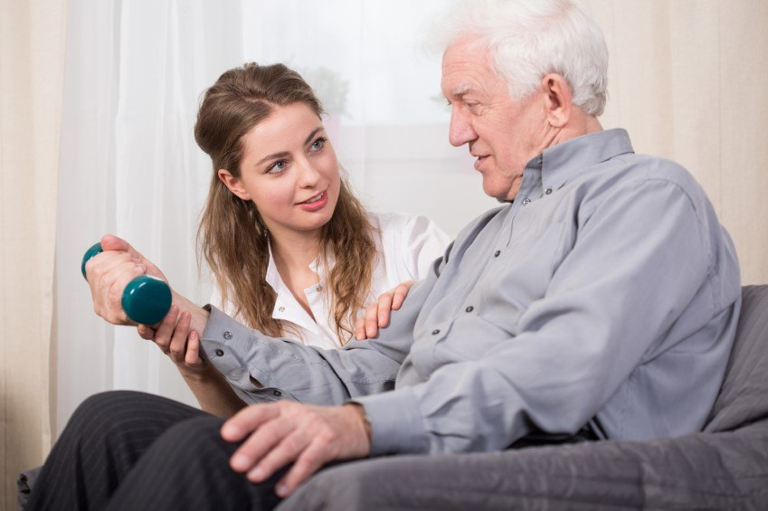
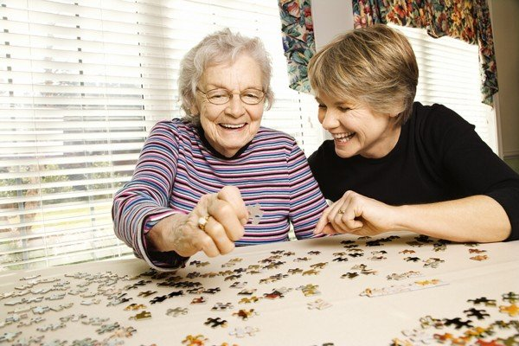
Interviews
Experiences with the healthcare system
Family doctors
Paramedics
ER healthcare providers
Hospital healthcare providers
Physiotherapists
Community support

Slide 22
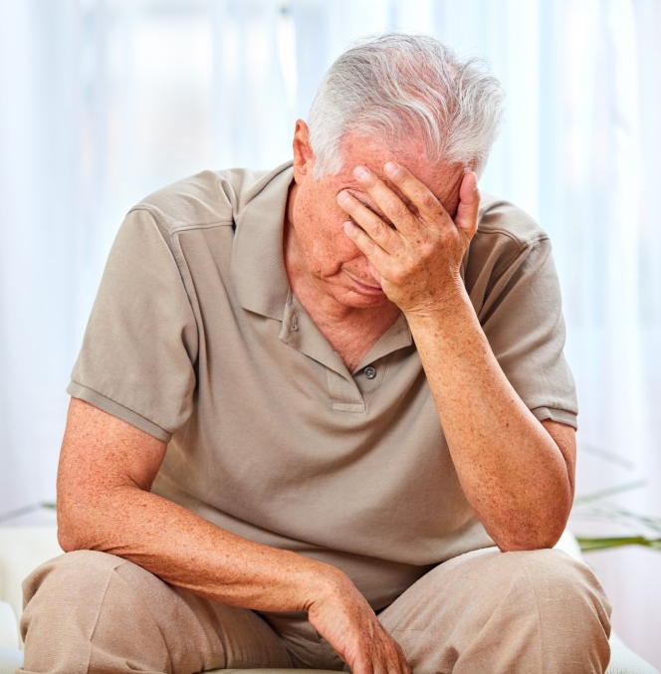
Interviews
Informal caregiver mental health
“I feel very alone”
“it has been extremely stressful.”
“the Alzheimer's Society has been good therapy for us, definitely.”
“I am slowly morphing into the two of us… my identity has started to become more with his. When he's no longer here, how do I put myself back together?”
POSITIVE…

Slide 23
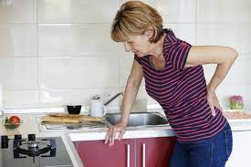
Interviews
Informal caregiver physical health
“Absolutely running on empty. That's the way I describe it. You're just putting one foot in front of the other … all of us were exhausted.”
“migraines, stiff neck and shoulders and headaches”
“I hurt, like, I hurt all over.”
“not being able to sleep”
“it’s hurting my back”
“you're postponing your own doctors appointments”
“I started going to the gym... I knew I needed to be strong. I knew I needed balance; I knew I needed strength.”

Slide 24
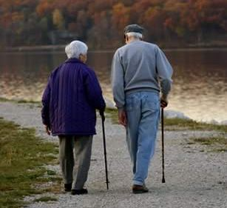
Interviews
What advice would you offer to other informal caregivers of PLWD at risk of falling?
“you've got to do this one day at a time, you can't zoom ahead. You've got to be in the moment and deal with what you've got”
“to prepare mentally because I was not prepared mentally. I did read it, but I wasn't prepared”
“don't take falls lightly”
“[there is a] number that you call for a fall from the fire department”
“please connect with the Alzheimer Society”
“you have to be ready to ask for and accept help”
“there's a lot of surprises and that sort of thing”
“don't underestimate the risk [of a fall]… it's just not worth it”

Slide 25
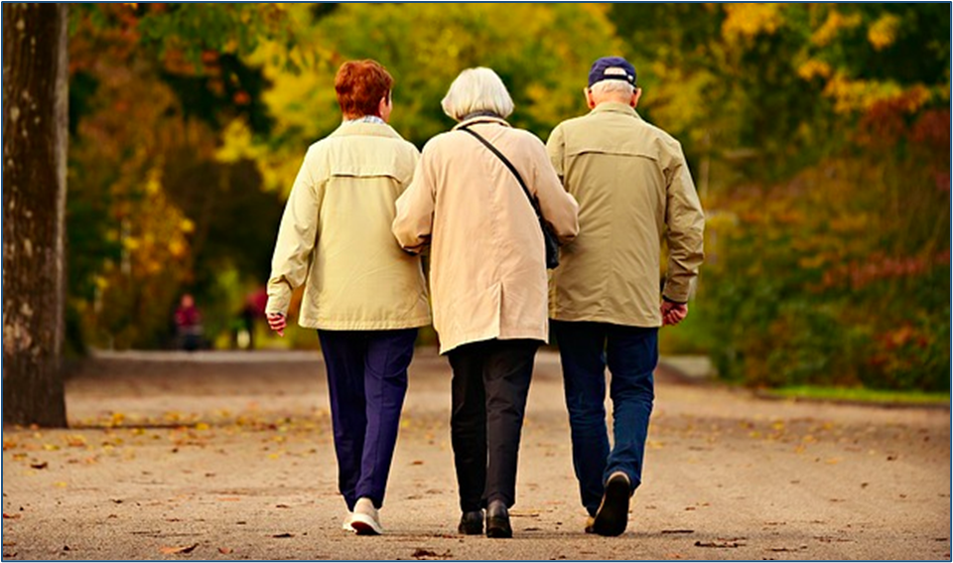
Next Steps

Slide 26




Acknowledgements

Slide 27

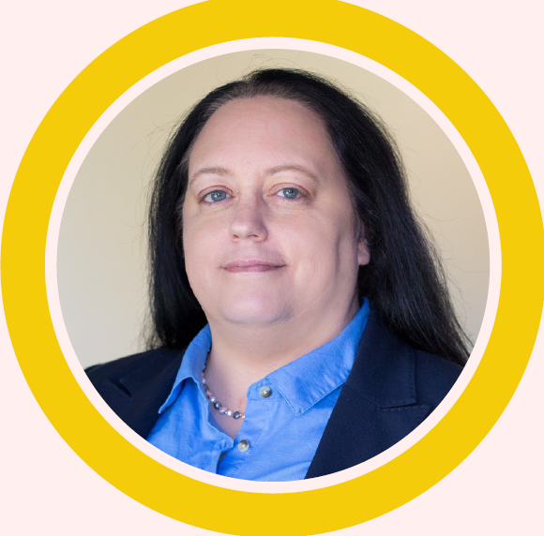


Contacts & References
The Alzheimer Society of Saskatoon provides a helpline service
for those living with dementia and their caregivers.
If you need to contact them the details can be found below.
Dementia Helpline: 1-877-949-4141
Email: helpline@alzheimer.sk.ca
Dr Michaela Lynds
michaela.lynds@usask.ca
Dr Cathy Arnold
cathy.arnold@usask.ca
Alzheimer Society of Canada (2016) Prevalence and monetary costs of dementia in Canada.
Canadian Institute for Health Information (2018) Dementia in Canada.
Public Health Agency of Canada (2014) Seniors’ falls in Canada: Second report.
Mesbah, N., Perry, M., Hill, K.D., Kaur, M. & Hale, L. (2017) Postural stability in older adults with Alzheimer disease.
Physical Therapy, 97(3), 290-309.

Slide 28
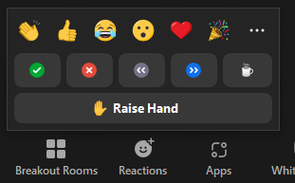
Questions?
If you have any questions, please use the chat function.
As people may have similar queries, we may combine questions.
Would you like to ask a question using your microphone?
Please turn your video on and raise your hand or use the ‘raise hand’ button.
First click on ‘Reactions’
Then click on ‘Raise Hand’

