Slide 1
Provincial and National Leadership in Physiotherapy
Notes:
Good afternoon. Thank you so much everyone for joining us today. Today’s event is being presented by the Saskatchewan Physiotherapy Association in partnership with the Office of the Treatment Commissioner and Continuing Education in Rehabilitation Science. Today Annie Battiste will be presenting Reconciliation, Treaty Relationships and Health Practitioners.

Slide 2
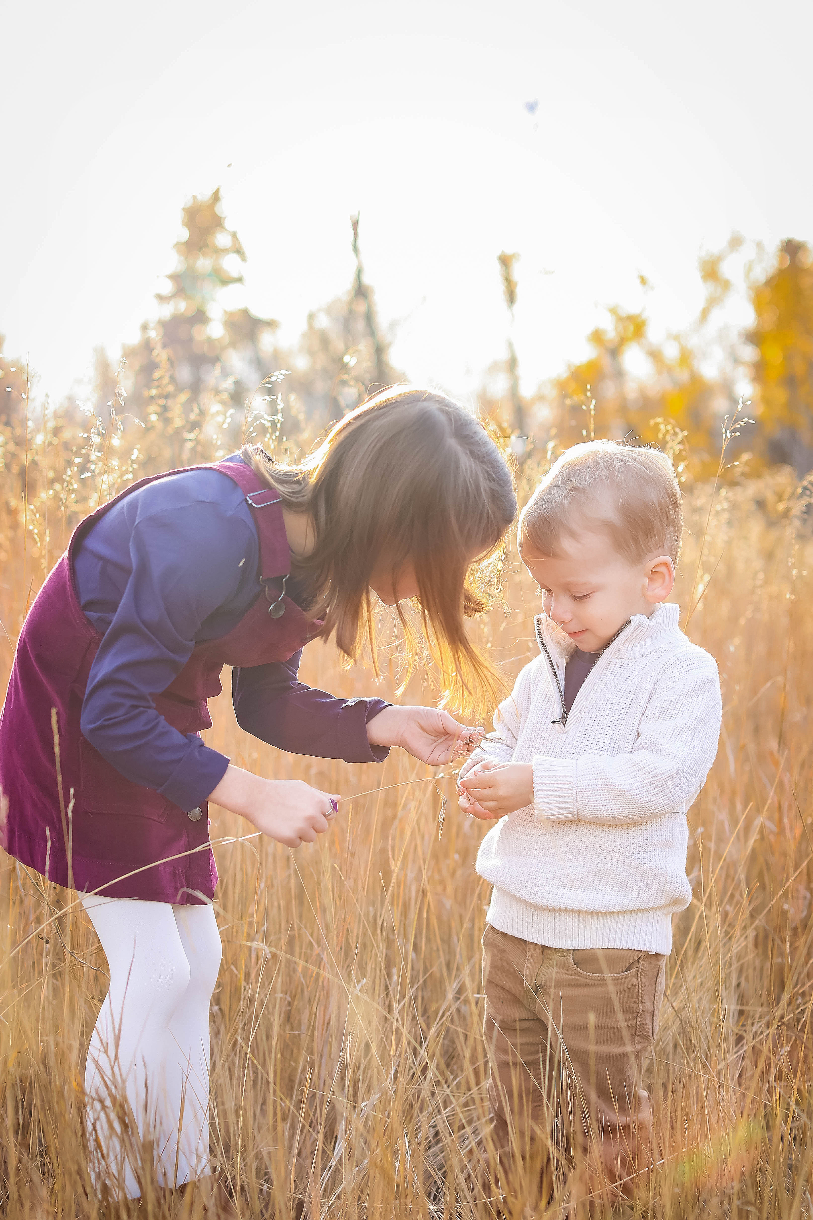
TREATY ACKNOWLEDGEMENT
“Our college acknowledges that our campuses and sites are on treaty territories and the Homeland of the Métis. We respect that Indigenous people have rich cultural and traditional practices that have been known to improve health outcomes. All attendees are invited to reflect on the territories you are calling in from as we commit ourselves to gaining knowledge; forging a new, culturally safe relationship; and contributing to reconciliation.”
Notes:
Before we begin, I would like to recognize that
“Our college acknowledges that our campuses and sites are on treaty territories and the Homeland of the Métis. We respect that Indigenous people have rich cultural and traditional practices that have been known to improve health outcomes.
As I present from Saskatoon, I acknowledge I am on Treaty 6 Territory and the Homeland of the Métis. We pay our respect to the First Nation and Métis ancestors of this place and reaffirm our relationship with one another.
I post a picture of my children here, reflecting on my gratitude to have been raised in the prairies and experience it anew through the eyes of my children and appreciate the gifts and opportunities of this land.
We are fortunate as healthcare providers to work across many territories in Saskatchewan. Present-day Saskatchewan includes small portions of land from Treaty 2 and Treaty 7, the five major historical or numbered treaties of this province are Treaty 4 (1874), Treaty 5 (1875–76), Treaty 6 (1876), Treaty 8 (1899–1900), and Treaty 10 (1906–07) (see Figure ATR-1).
All attendees are invited to reflect on the territories you are calling in from as we commit ourselves to gaining knowledge; forging a new, culturally safe relationship; and contributing to reconciliation.”

Slide 3
Attendees
Attendees will be automatically muted; please remain muted for the duration of the presentation.
Chat function will be enabled, attendees can chat privately with other attendees, panelists, hosts. This feature will not be monitored for questions.
Attendees will be able to raise their hand virtually during the Q&A periods to request to be called on to ask a question verbally.
Q&A function will be enabled, the Q & A button enables you to ask questions to the webinar host and panelists. There will be ample opportunity given during conference for attendees to ask questions.
Notes:
For the duration of today’s virtual conference, all attendees will be automatically muted with no video option. Chat will be enabled for attendees to chat with other attendees and CERS hosts. We welcome your comments and feedback on each presentation, but the chat box will not be monitored for questions.
Attendees will be able to raise their hands virtually during the Q&A period to request to be unmuted to request the host unmute them so they may ask a question verbally.
Question and answer periods will be provided after each presentation. Questions must be typed into the Q&A panel and will be addressed, where possible and in the order, they are received. We will monitor this panel for the speakers today. We encourage you to engage with our speakers during that time.

Slide 4
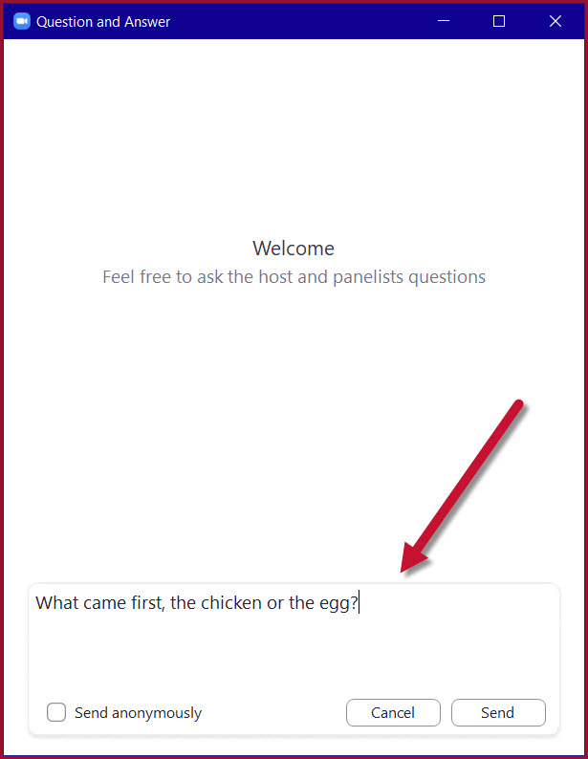
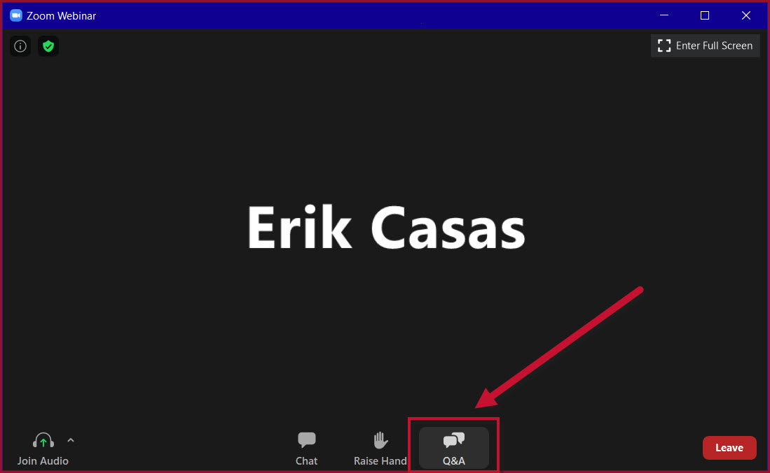
Asking a Written Question
The Q&A panel allows you to ask questions of our panelists.
Q&A is in the bottom of your screen.
Submit your written question using the Q&A function.
Once submitted, panelists can choose to answer your question by text or live.
Once a question has been answered it will appear in the Q&A box for all attendees to see.
Chat feature is enabled for interaction & feedback.
The moderator will address as many questions as possible, when possible and in the order, they are received. Apologies in advance if your question does not get answered.
Notes:
The Q&A option is located at the bottom of your screen. You can use this function to submit questions to the host and panelists.
You can send your question publicly so that all website attendees can see who has asked it or you can send it anonymously. To do this, type your question into the input box and then tick the ‘Send Anonymously box’.
Once submitted, the panelists can choose to answer your question by text or live. If they answer your question live, you will see a message appear below your question and the host/panelist will answer your question out loud.
Once a question has been answered, it will appear in the Q&A box for all attendees to view.

Slide 5
“I can’t hear anything”
Bad audio?
Turn your system up
Click on the Join Audio option at the bottom right
Use a good headset
Low network quality will be a factor
Network Issues?
Leave the event and try coming back in
Use the chat feature to connect with the Host for further troubleshooting support
Notes:
Sometimes tech issues occur
Even though Zoom asks you to let it use your computer’s audio before joining a meeting, at times, one misses it. That could be the reason why others are unable to hear you. To fix it, click on the Join Audio option present at the bottom right.
If you are experiencing network issues, this could affect your audio.
To help troubleshoot these issues we encourage you to sign out of zoom, re-join via the same link and be sure to join via computer audio. You can also chat with our CERS host in the chat panel for further support.

Slide 7
Microsoft Stock Images
Notes:
Now that I’ve wrapped up all my house keeping, let’s get started with our conference, I will hand the mic over to our hosts for today Chad Magee and Adrianne Vangool

